Slide 1
Blind Test Healthy vs lung stage 1 Cancer Plasma Samples based on Exosome count using PANORAMA

Slide 2
Experimental Details for Blinded Healthy and Stage 1 Lung Cancer Plasma Samples
Used samples: 1-100 Blinded.
Plasma volume: 20 µl.
Type of Cancer: unknown.
Concentration: unknown.
Size Distribution: unknown.
Experimental duration: 60 min.
Antibody used: CD9, CD81, and CD63.

Slide 3
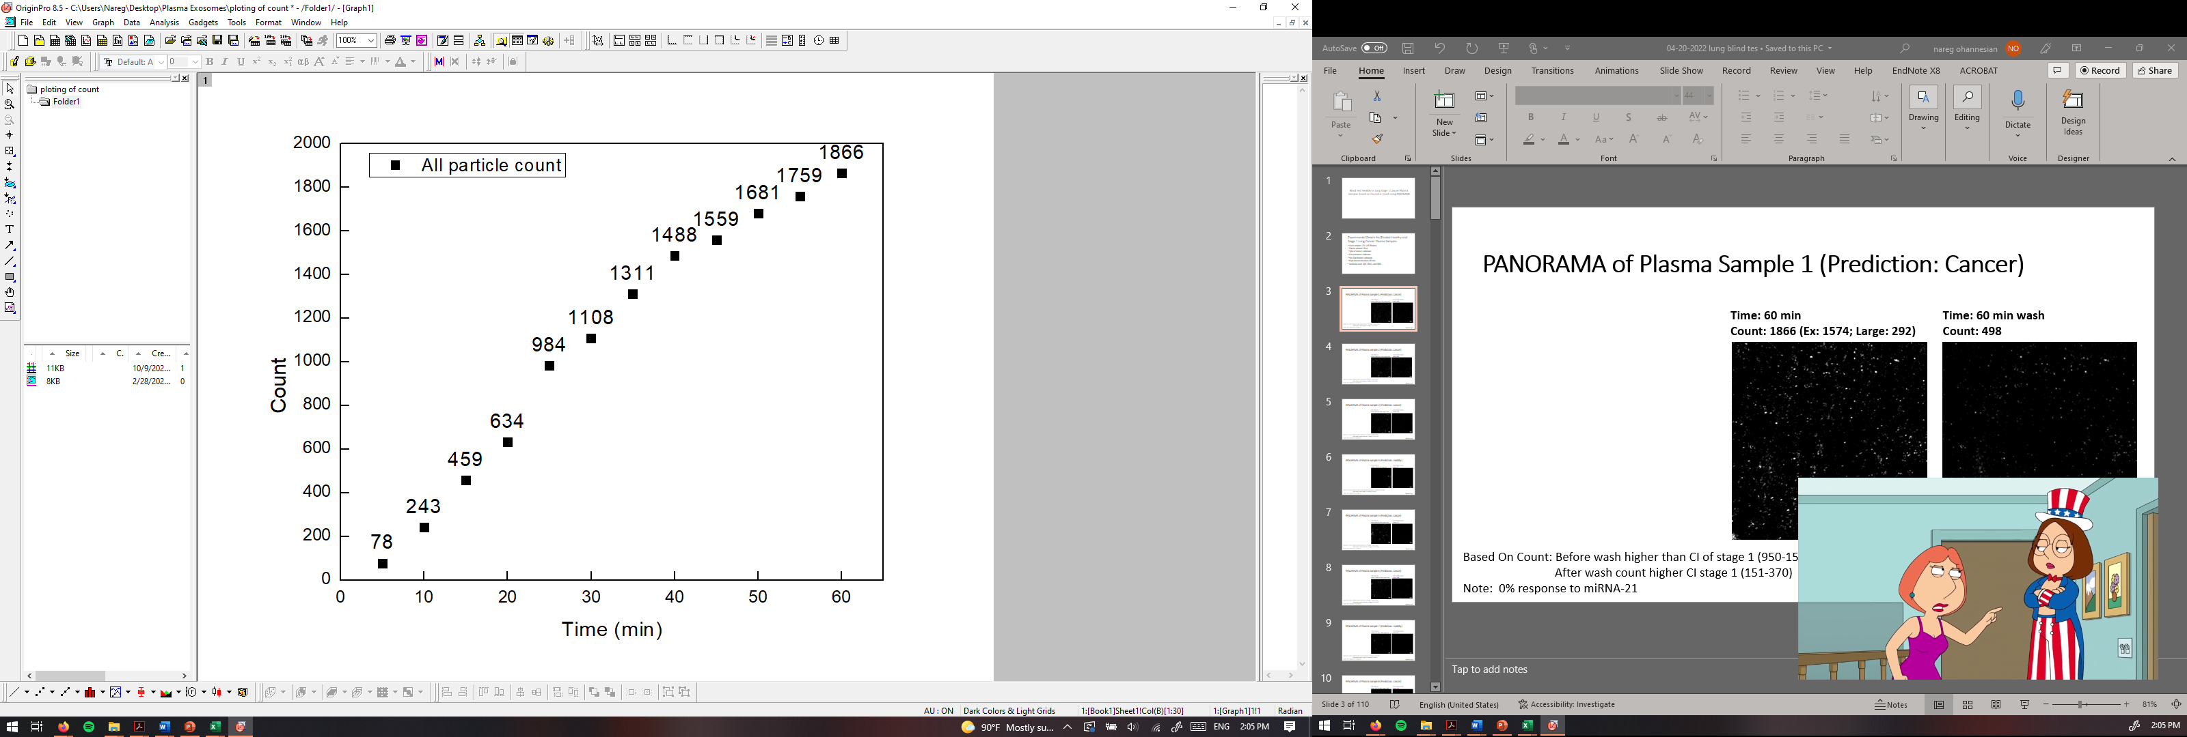
PANORAMA of Plasma Sample 1 (Prediction: Cancer)
Time: 60 min
Count: 1866 (Ex: 1574; Large: 292)
Time: 60 min wash
Count: 925
Based On Count: Before wash higher than CI of stage 1 (950-1558)
After wash count higher CI stage 1 (151-370)
Note: 0% response to miRNA-21
Scale bar: 10 µm

Slide 4
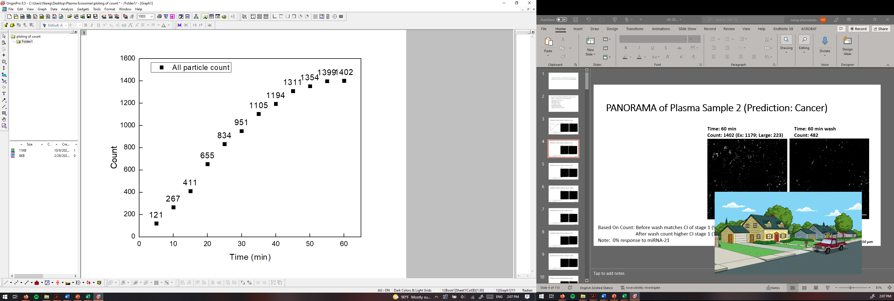
PANORAMA of Plasma Sample 2 (Prediction: Cancer)
Time: 60 min
Count: 1402 (Ex: 1179; Large: 223)
Time: 60 min wash
Count: 611
Based On Count: Before wash matches CI of stage 1 (950-1558)
After wash count higher CI stage 1 (151-370)
Note: 0% response to miRNA-21
Scale bar: 10 µm

Slide 5
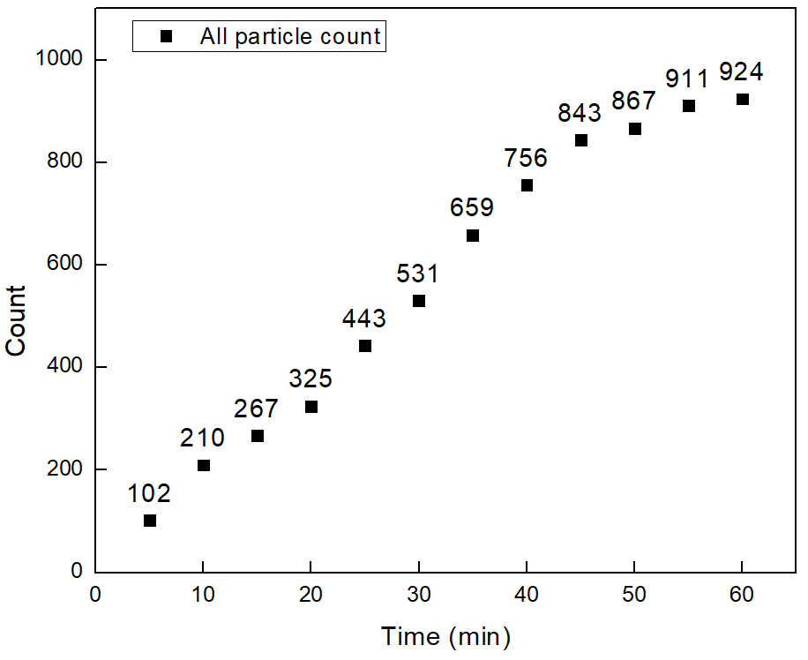


PANORAMA of Plasma Sample 3 (Prediction: Cancer)
Time: 60 min
Count: 924 (Ex: 594; Large: 330)
Time: 60 min wash
Count: 272
Based On Count: Before wash matches CI of stage 1 (950-1558)
After wash count matches CI stage 1 (151-370)
Note: 0% response to miRNA-21
Scale bar: 10 µm

Slide 6
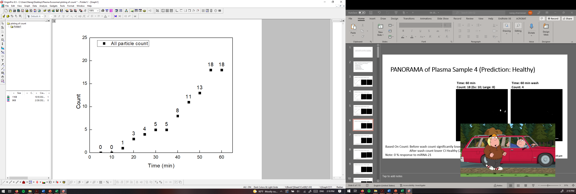

PANORAMA of Plasma Sample 4 (Prediction: Healthy)
Time: 60 min
Count: 18 (Ex: 10; Large: 8)
Time: 60 min wash
Count: 4
Based On Count: Before wash count significantly lower CI Healthy (214-263)
After wash count lower CI Healthy (24-34)
Note: 0 % response to miRNA-21
Scale bar: 10 µm

Slide 7
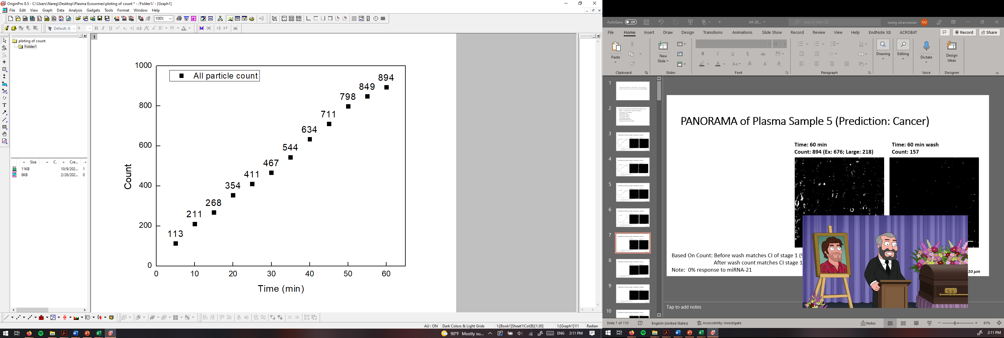
PANORAMA of Plasma Sample 5 (Prediction: Cancer)
Time: 60 min
Count: 894 (Ex: 676; Large: 218)
Time: 60 min wash
Count: 157
Based On Count: Before wash matches CI of stage 1 (950-1558)
After wash count matches CI stage 1 (151-370)
Note: 0% response to miRNA-21
Scale bar: 10 µm

Slide 8
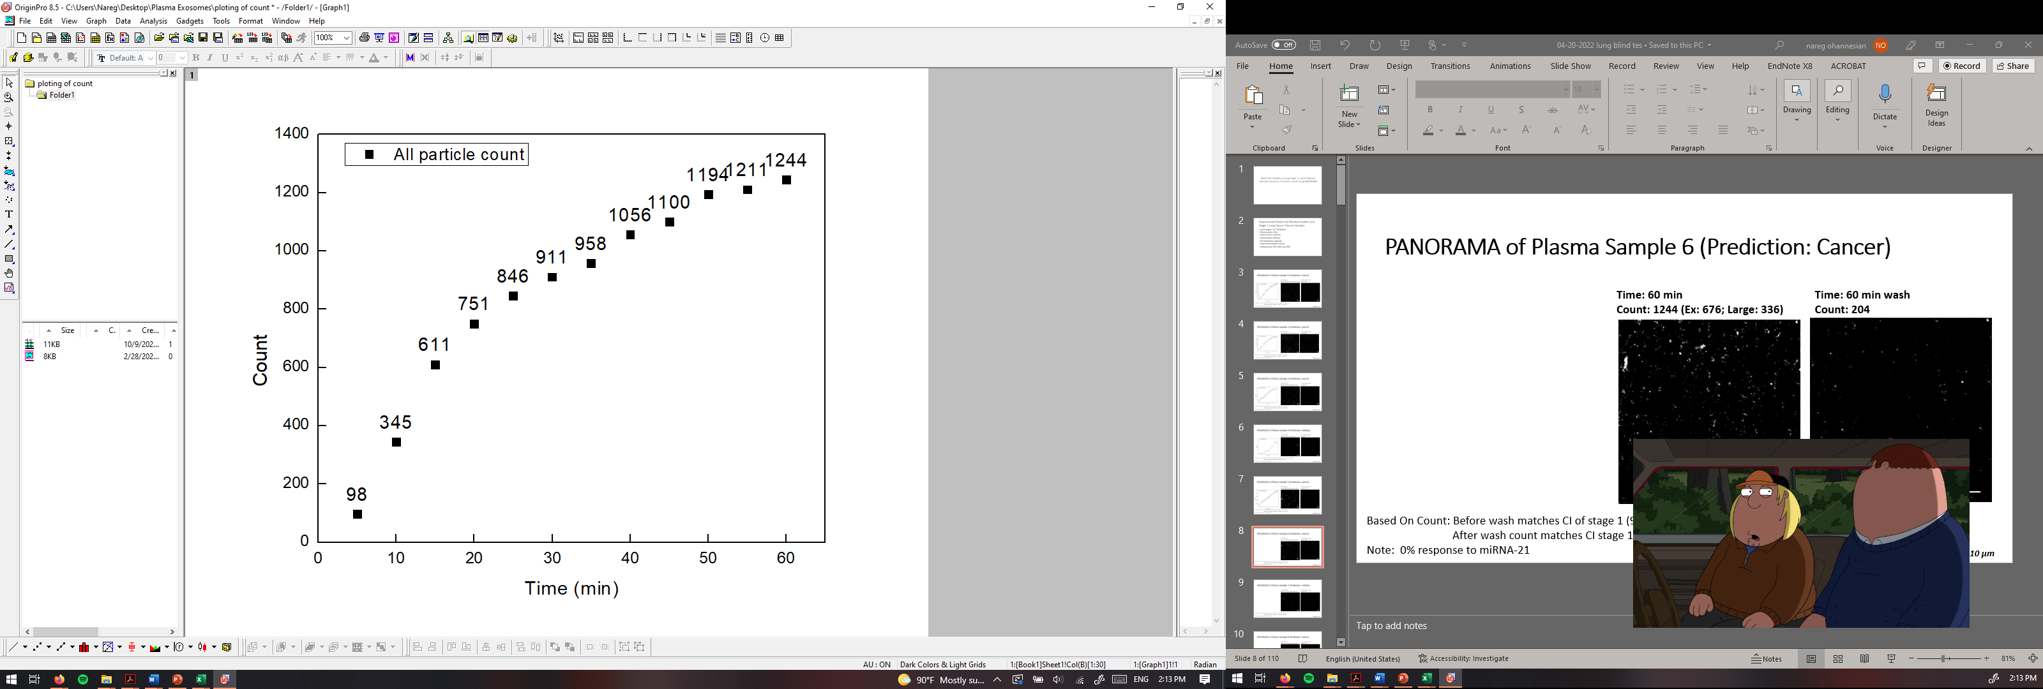
PANORAMA of Plasma Sample 6 (Prediction: Cancer)
Time: 60 min
Count: 1244 (Ex: 676; Large: 336)
Time: 60 min wash
Count: 204
Based On Count: Before wash matches CI of stage 1 (950-1558)
After wash count matches CI stage 1 (151-370)
Note: 0% response to miRNA-21
Scale bar: 10 µm

Slide 9
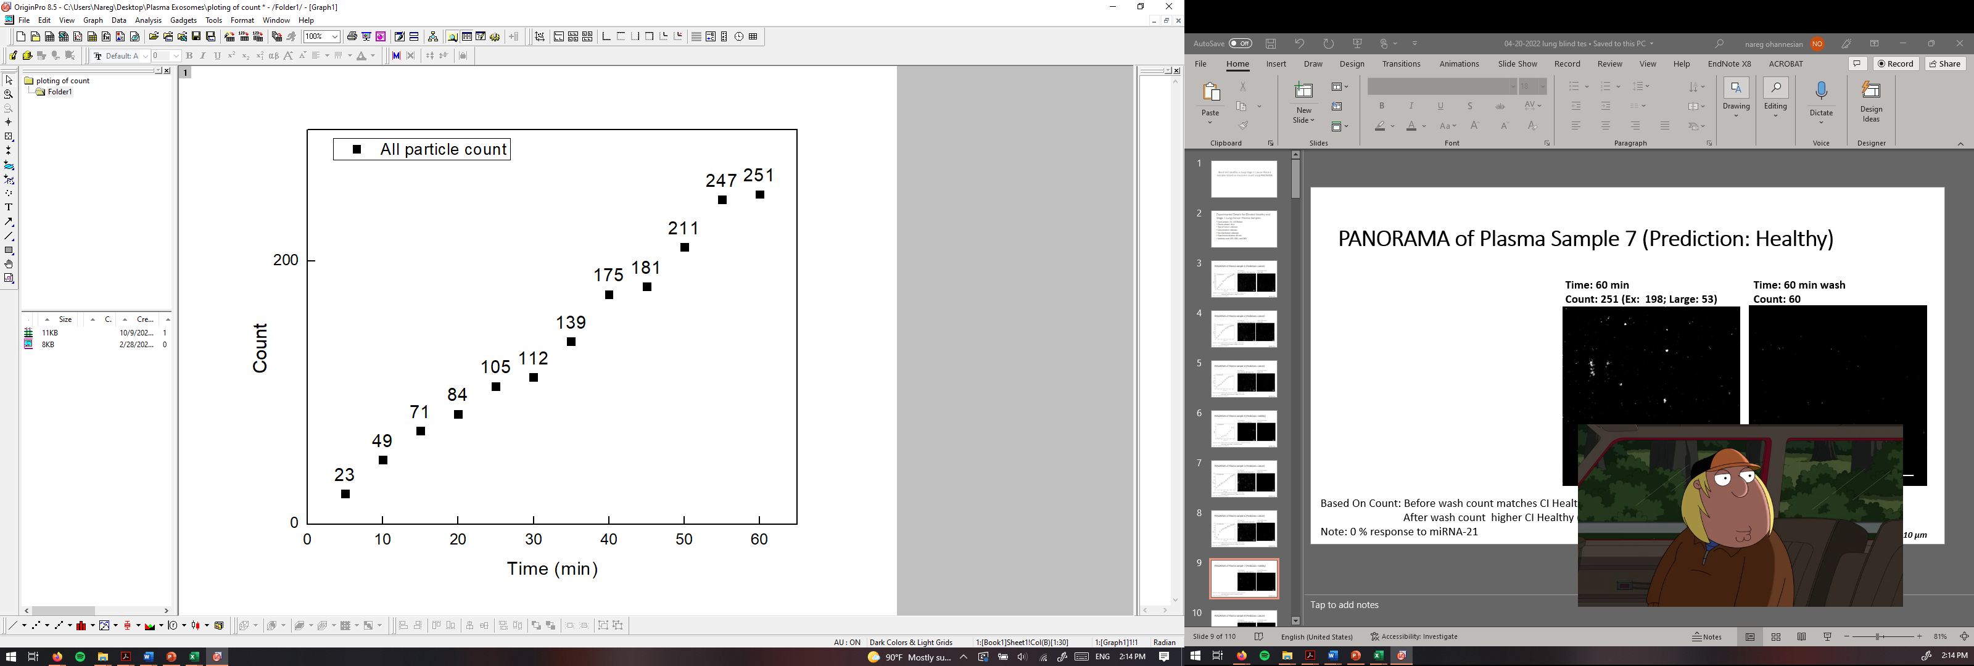
PANORAMA of Plasma Sample 7 (Prediction: Healthy)
Time: 60 min
Count: 251 (Ex: 198; Large: 53)
Time: 60 min wash
Count: 60
Based On Count: Before wash count matches CI Healthy (214-263)
After wash count higher CI Healthy (24-34)
Note: 0 % response to miRNA-21
Scale bar: 10 µm

Slide 10
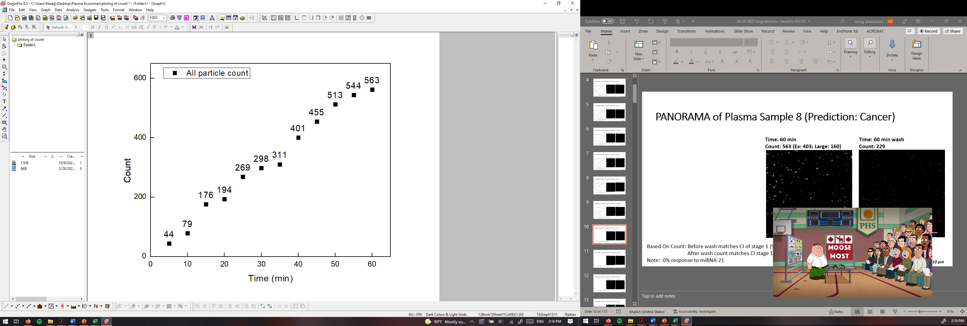

PANORAMA of Plasma Sample 8 (Prediction: Cancer)
Time: 60 min
Count: 563 (Ex: 403; Large: 160)
Time: 60 min wash
Count: 229
Based On Count: Before wash matches CI of stage 1 (950-1558)
After wash count matches CI stage 1 (151-370)
Note: 0% response to miRNA-21
Scale bar: 10 µm

Slide 11
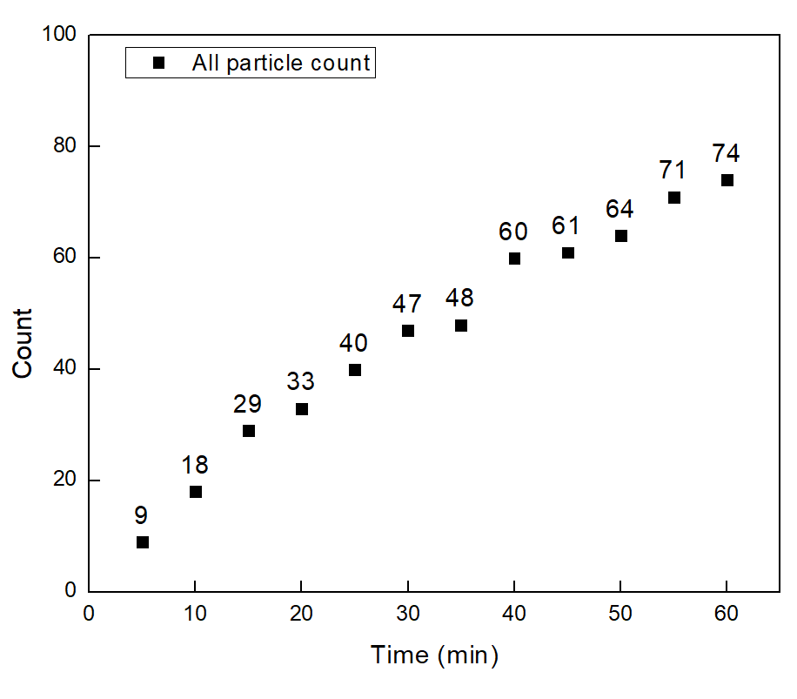

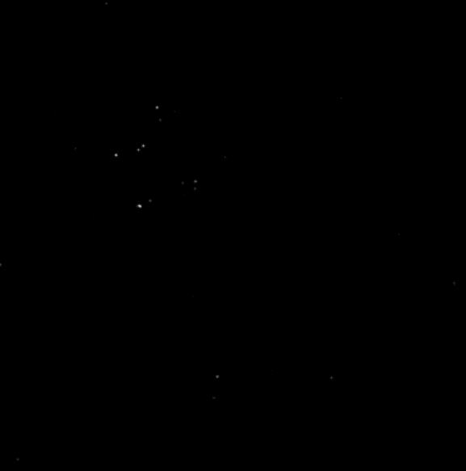
PANORAMA of Plasma Sample 9 (Prediction: Healthy)
Time: 60 min
Count: 74 (Ex: 61; Large: 13)
Time: 60 min wash
Count: 17
Based On Count: Before wash count lower CI Healthy (214-263)
After wash count lower CI Healthy (24-34)
Note: 0 % response to miRNA-21
Scale bar: 10 µm

Slide 12
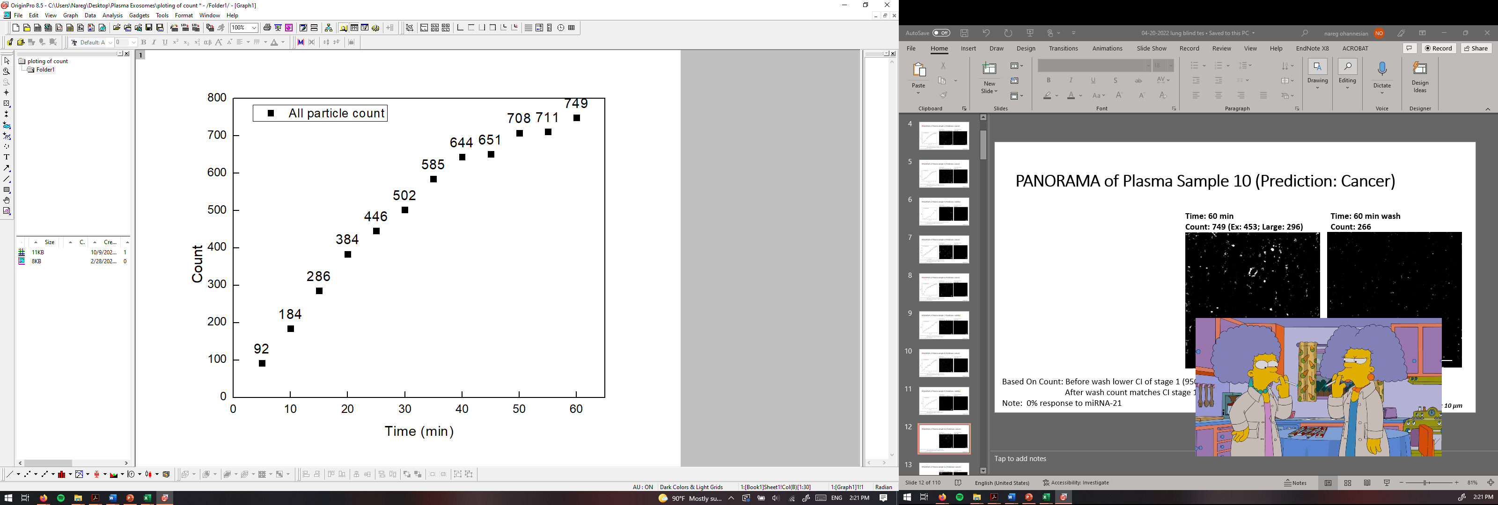
PANORAMA of Plasma Sample 10 (Prediction: Cancer)
Time: 60 min
Count: 749 (Ex: 453; Large: 296)
Time: 60 min wash
Count: 266
Based On Count: Before wash lower CI of stage 1 (950-1558)
After wash count matches CI stage 1 (151-370)
Note: 0% response to miRNA-21
Scale bar: 10 µm

Slide 13
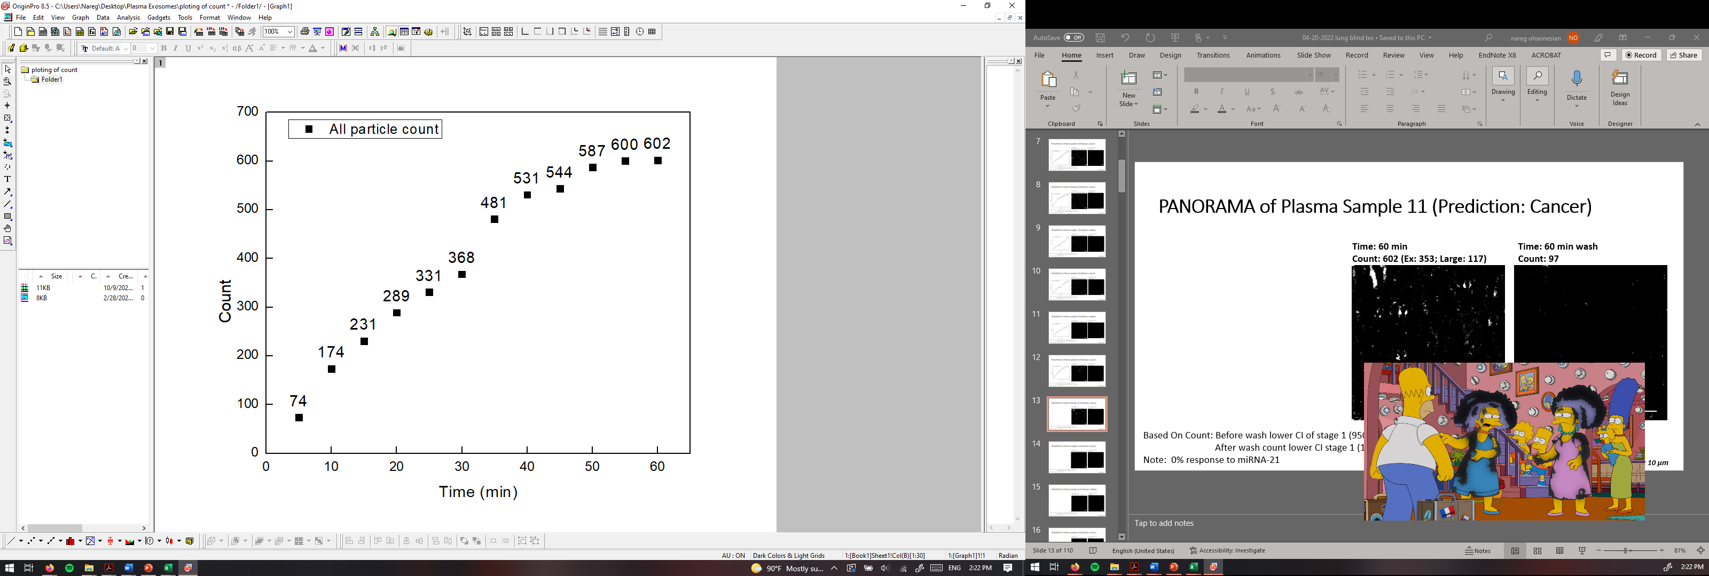
PANORAMA of Plasma Sample 11 (Prediction: Cancer)
Time: 60 min
Count: 602 (Ex: 353; Large: 117)
Time: 60 min wash
Count: 97
Based On Count: Before wash lower CI of stage 1 (950-1558)
After wash count lower CI stage 1 (151-370)
Note: 0% response to miRNA-21
Scale bar: 10 µm

Slide 14
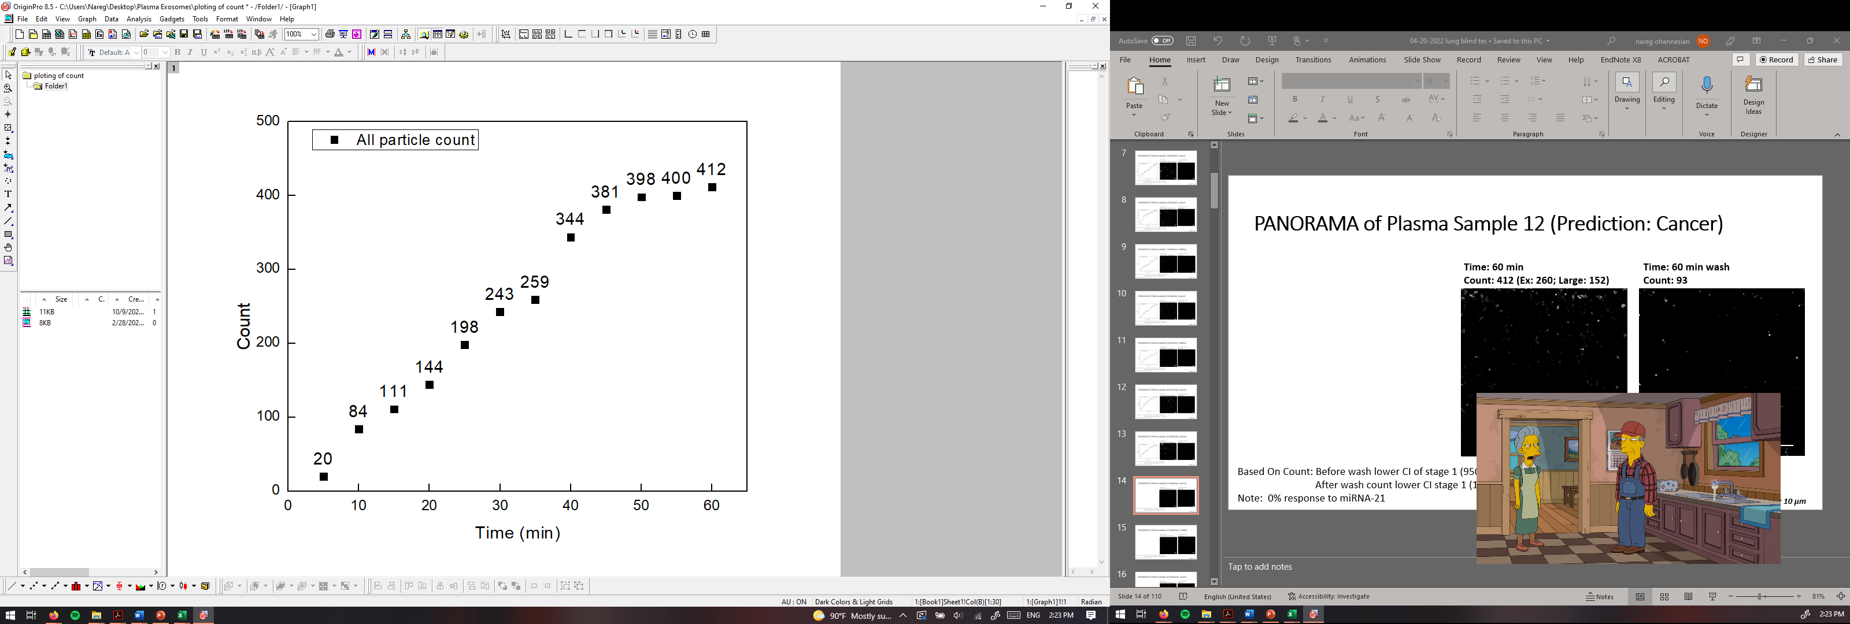
PANORAMA of Plasma Sample 12 (Prediction: Cancer)
Time: 60 min
Count: 412 (Ex: 260; Large: 152)
Time: 60 min wash
Count: 93
Based On Count: Before wash lower CI of stage 1 (950-1558)
After wash count lower CI stage 1 (151-370)
Note: 0% response to miRNA-21
Scale bar: 10 µm

Slide 15
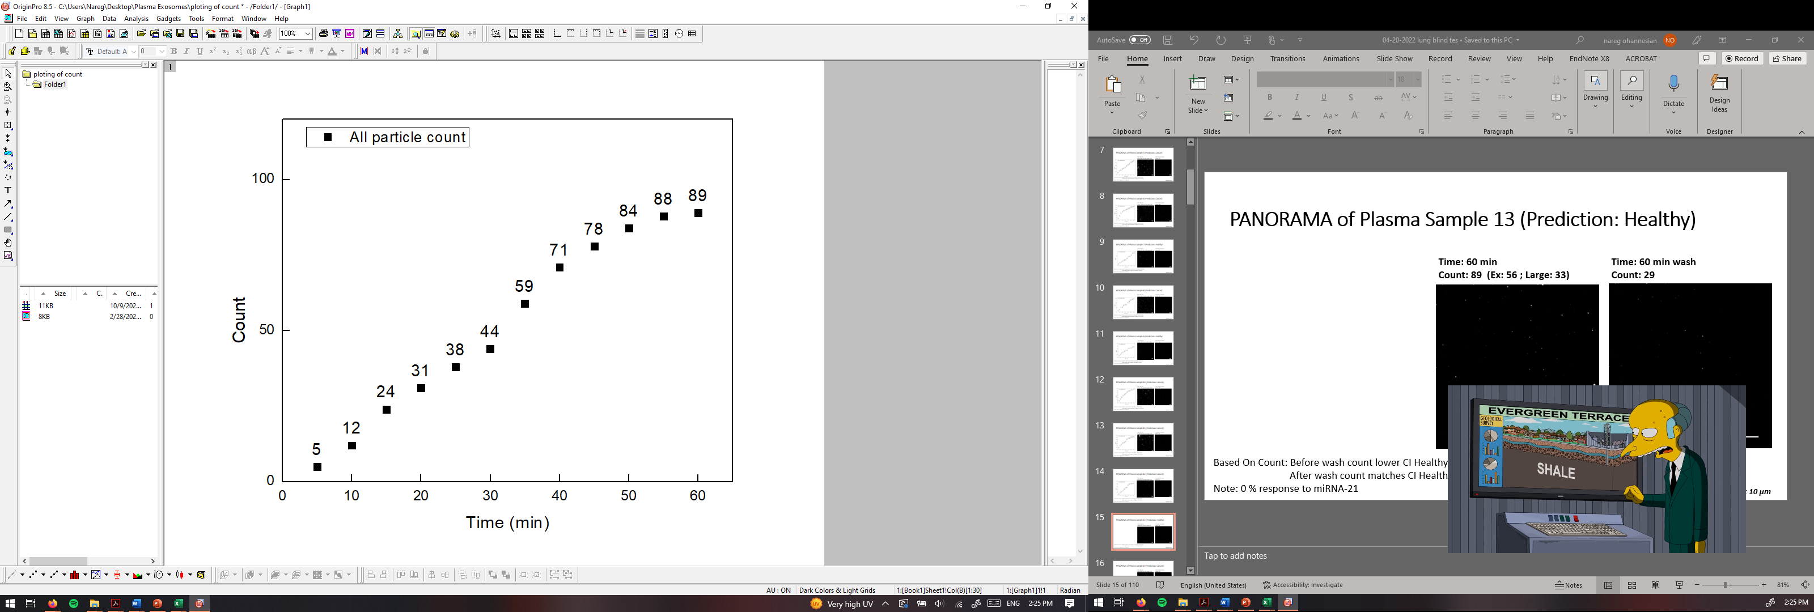

PANORAMA of Plasma Sample 13 (Prediction: Healthy)
Time: 60 min
Count: 89 (Ex: 56 ; Large: 33)
Time: 60 min wash
Count: 29
Based On Count: Before wash count lower CI Healthy (214-263)
After wash count matches CI Healthy (24-34)
Note: 0 % response to miRNA-21
Scale bar: 10 µm

Slide 16
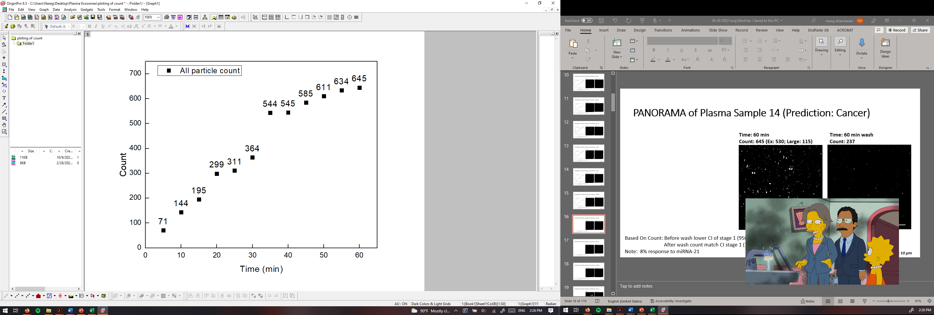
PANORAMA of Plasma Sample 14 (Prediction: Cancer)
Time: 60 min
Count: 645 (Ex: 530; Large: 115)
Time: 60 min wash
Count: 237
Based On Count: Before wash lower CI of stage 1 (950-1558)
After wash count match CI stage 1 (151-370)
Note: 8% response to miRNA-21
Scale bar: 10 µm

Slide 17
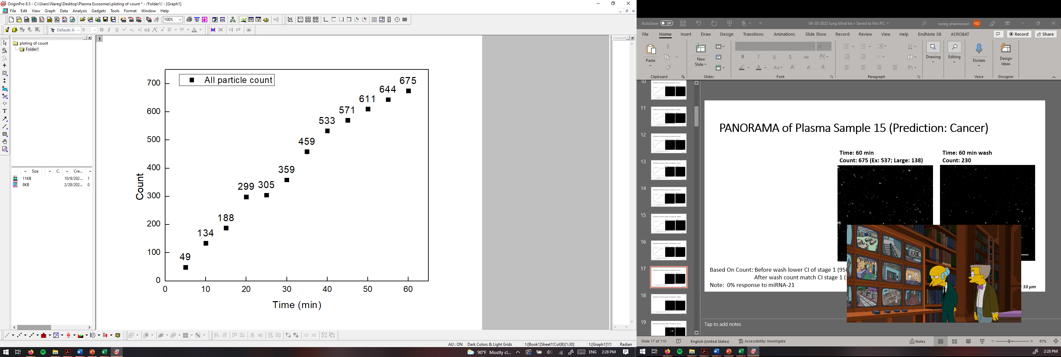
PANORAMA of Plasma Sample 15 (Prediction: Cancer)
Time: 60 min
Count: 675 (Ex: 537; Large: 138)
Time: 60 min wash
Count: 230
Based On Count: Before wash lower CI of stage 1 (950-1558)
After wash count match CI stage 1 (151-370)
Note: 0% response to miRNA-21
Scale bar: 10 µm

Slide 18
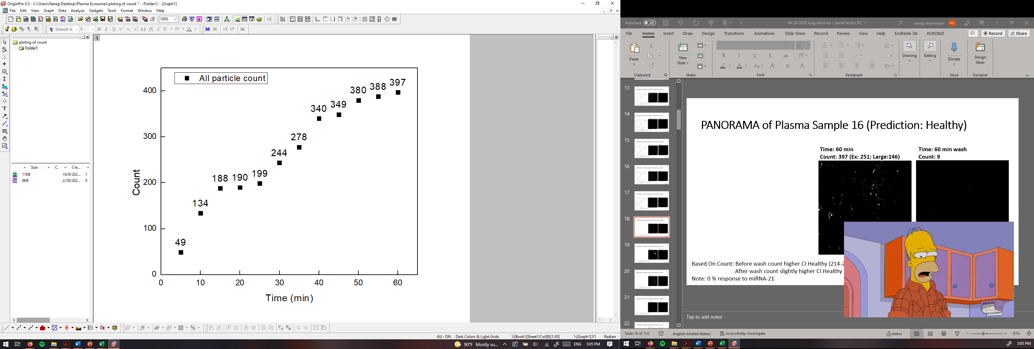
PANORAMA of Plasma Sample 16 (Prediction: Healthy)
Time: 60 min
Count: 397 (Ex: 251; Large:146)
Time: 60 min wash
Count: 9
Based On Count: Before wash count higher CI Healthy (214-263)
After wash count slightly higher CI Healthy (24-34)
Note: 0 % response to miRNA-21
Scale bar: 10 µm

Slide 19


PANORAMA of Plasma Sample 17 (Prediction: Cancer)
Time: 60 min
Count: 825 (Ex: 512; Large: 313)
Time: 60 min wash
Count: 178
Based On Count: Before wash slightly lower CI of stage 1 (950-1558)
After wash count match CI stage 1 (151-370)
Note: 0% response to miRNA-21
Scale bar: 10 µm

Slide 20


PANORAMA of Plasma Sample 18 (Prediction: Cancer)
Time: 60 min
Count: 988 (Ex: 563; Large: 524)
Time: 60 min wash
Count: 151
Based On Count: Before wash lower CI of stage 1 (950-1558)
After wash count match CI stage 1 (151-370)
Note: 0% response to miRNA-21
Scale bar: 10 µm

Slide 21


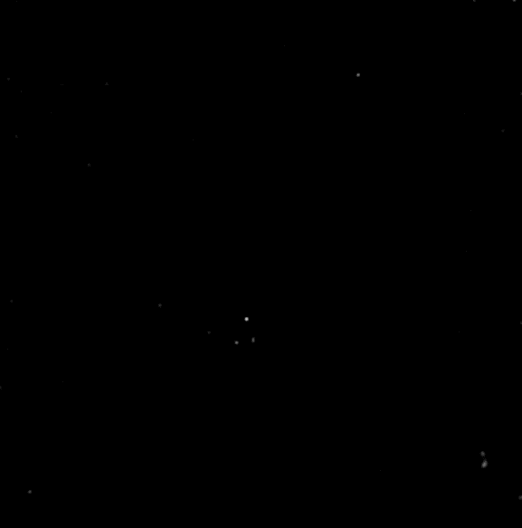
PANORAMA of Plasma Sample 19 (Prediction: Healthy)
Time: 60 min
Count: 81 (Ex: 76; Large:5)
Time: 60 min wash
Count: 10
Based On Count: Before wash count lower CI Healthy (214-263)
After wash count lower CI Healthy (24-34)
Note: 0 % response to miRNA-21
Scale bar: 10 µm

Slide 22
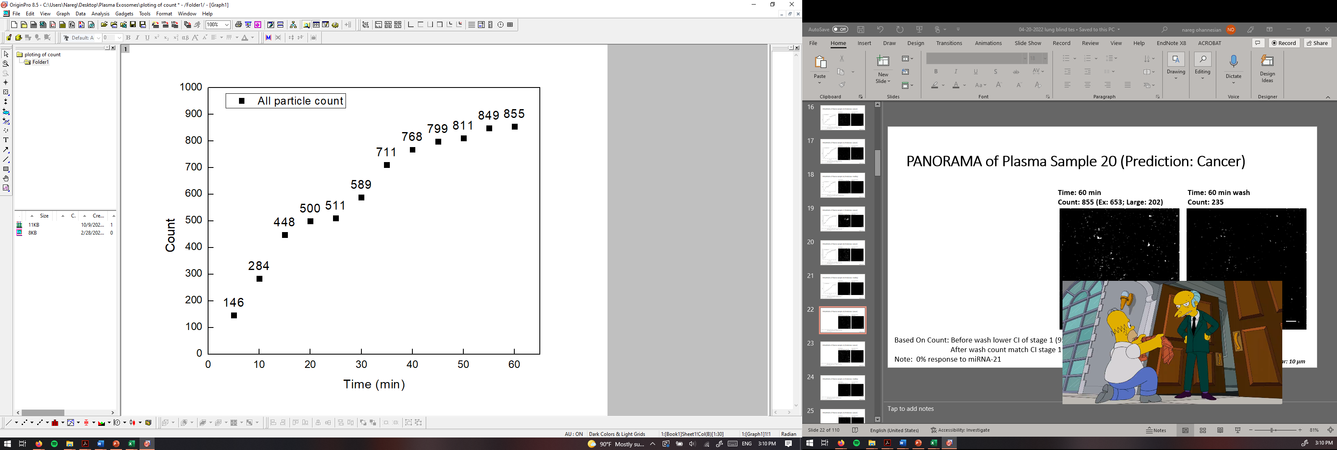
PANORAMA of Plasma Sample 20 (Prediction: Cancer)
Time: 60 min
Count: 855 (Ex: 653; Large: 202)
Time: 60 min wash
Count: 235
Based On Count: Before wash lower CI of stage 1 (950-1558)
After wash count match CI stage 1 (151-370)
Note: 0% response to miRNA-21
Scale bar: 10 µm

Slide 23
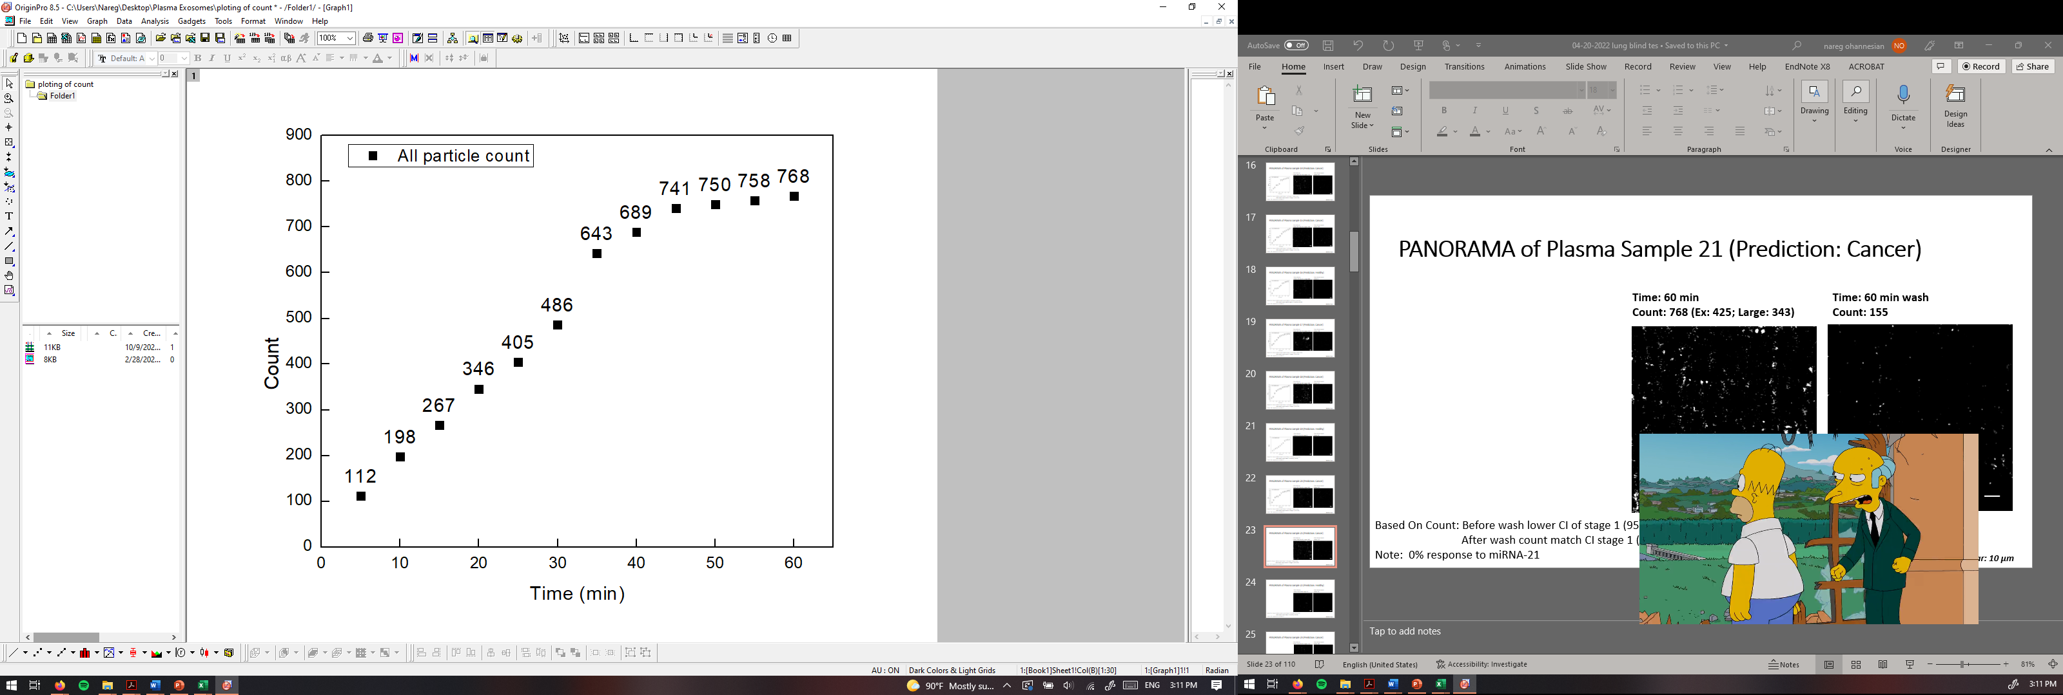
PANORAMA of Plasma Sample 21 (Prediction: Cancer)
Time: 60 min
Count: 768 (Ex: 425; Large: 343)
Time: 60 min wash
Count: 155
Based On Count: Before wash lower CI of stage 1 (950-1558)
After wash count match CI stage 1 (151-370)
Note: 0% response to miRNA-21
Scale bar: 10 µm

Slide 24
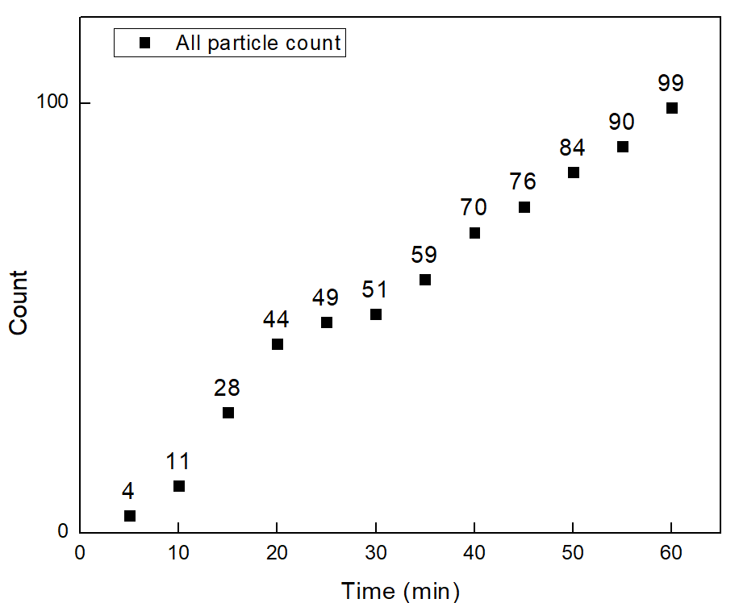
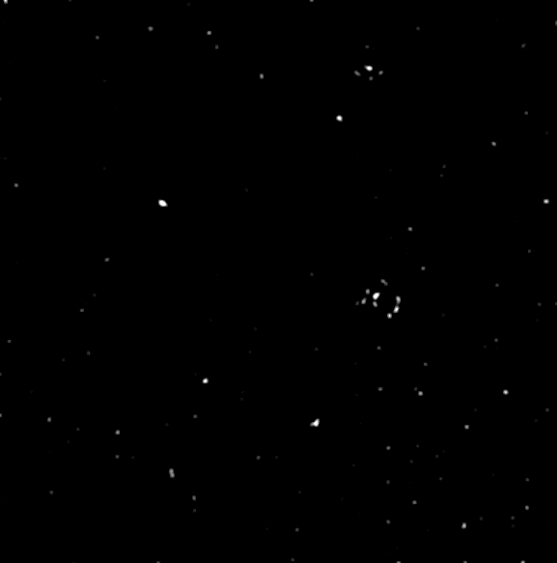

PANORAMA of Plasma Sample 22 (Prediction: Healthy)
Time: 60 min
Count: 99 (Ex: 84; Large:15)
Time: 60 min wash
Count: 19
Based On Count: Before wash count lower CI Healthy (214-263)
After wash count lower CI Healthy (24-34)
Note: 0 % response to miRNA-21
Scale bar: 10 µm

